Slide 1

TMDB Analysis
Ameeshi Gupta | Darren Chan | Koh Jia Cheng
CZ1115 | AY20/21 S2
Notes:
Hi! Welcome to TMDB Analysis for CZ1115. I am Darren and my group consist of me, Ameeshi & Jia Cheng. Today we will be conducting an in depth analysis of the TMDB Dataset

Slide 2
AGENDA
Exploratory
Data Analysis
Introduction
Conclusion
Wrangling
Machine Learning
Problem Statement
Analysis & Observations
Outcome & Insights
Data Collection & Organisation
Logistics Regression Model
CZ1115 | AY20/21 S2
Notes:
The agenda for today will be as follows:
We will start off with a brief introduction of the dataset and the problem statement that we have formulated
We will showcase how we extract data from TMDB using their API key, then we will discuss some of the conditions we took with regards to data preparation
We will present our observation from the EDA supported with visual evidence
We will use logistic regression model for the machine learning of our project
Lastly, we will present our key findings and recommendations

Slide 3
Problem Statement
Will The Film Be Successful?
Film’s investor point of view to determine if the production will be profitable & what factors contribute to a film’s success
Introduction
Wrangling
Analysis
Machine Learning
Conclusion
Notes:
Today, we will be looking at this problem. As a film investor, how do i determine if the film is profitable and what factors contribute the most to a film’s success?

Slide 4
DATA WRANGLING
API Call
Real Value
RegEx & Inline
Extract and Store in a CSV file
Using US Inflation Rate
Clean & Group the data
Introduction
Wrangling
Analysis
Machine Learning
Conclusion
Notes:
Moving to Data Wrangling. We utilised the API to iteratively call for data and store them in a CSV file. This CSV file will be our main dataset for this project. 2nd, the all monetary values are accounted for US inflation rate. 3rd, we utilise regex & inline to transform into desired form

Slide 5
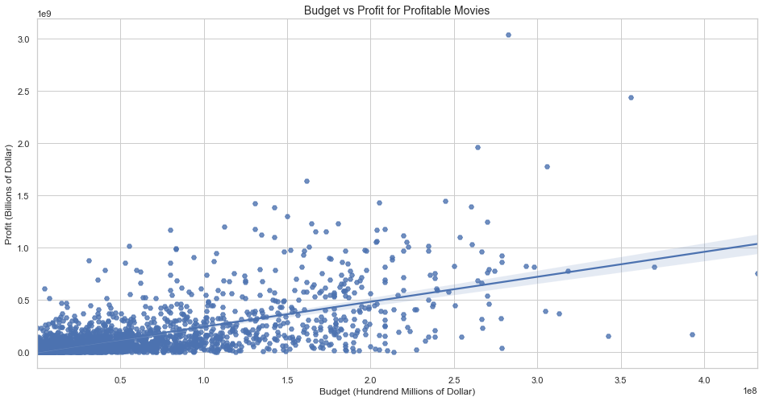
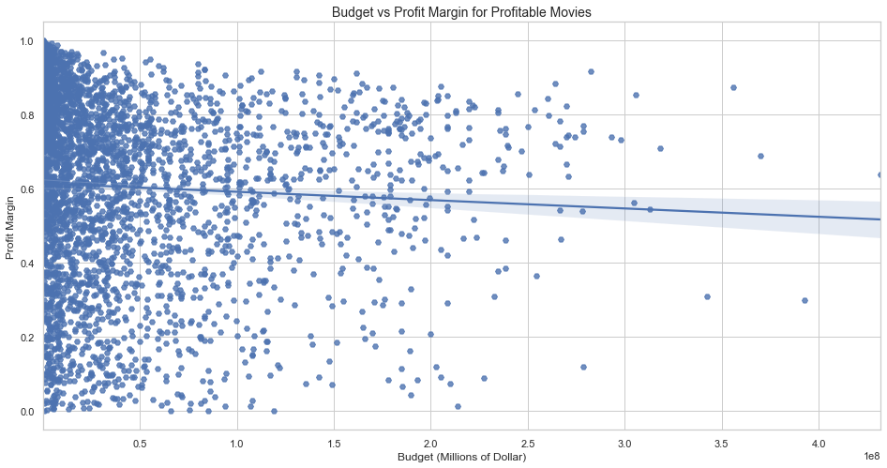
Budget vs Profit Margin
Negative Correlation with Budget and Profit Margin
Diminishing Profit Margin as Budget increases
Budget should be kept to a minimum
Introduction
Wrangling
Analysis
Machine Learning
Conclusion
Notes:
We have highlighted 4 EDA findings to present in this video. 1st, we will be looking at the budget vs Profit Margin. We have discovered a negative correlation between the budget and profit margin. This represents a diminishing profit margin as budget increases and thus, Budget should be kept to a minimum.

Slide 6
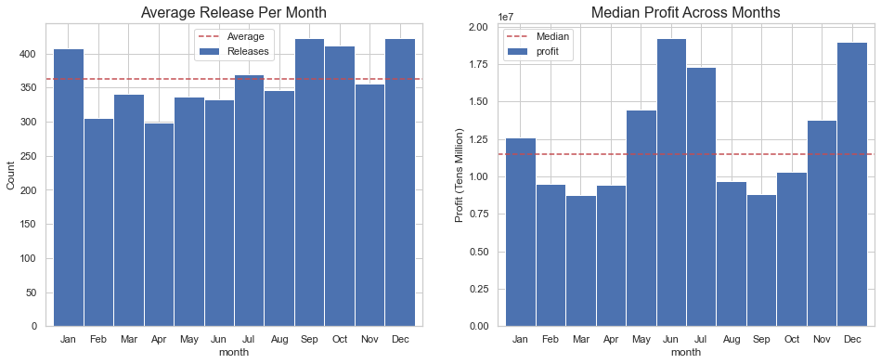
Profit by Months
September to January less November have the highest release of films
June, July & December are months that have a high Profit
Introduction
Wrangling
Analysis
Machine Learning
Conclusion
Notes:
2nd, We will be looking by months. We realised that from September to January( ex. nov) have the highest release of films. Looking into the profits we have identified June, July & December as months that have a relatively higher median profit.
There is a caveat; High Profits can be skewed by outliers e.g. blockbusters

Slide 7
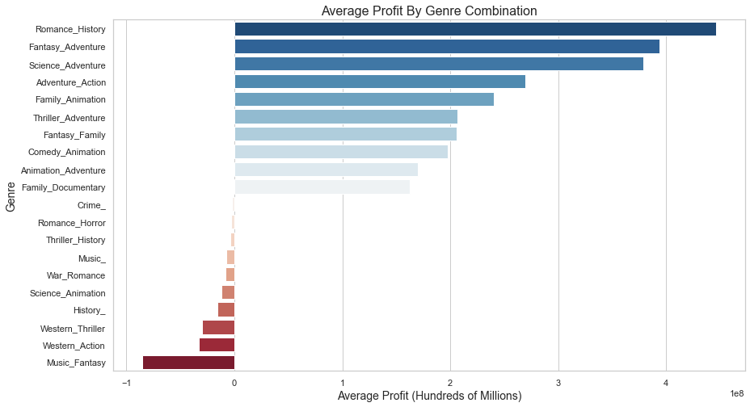
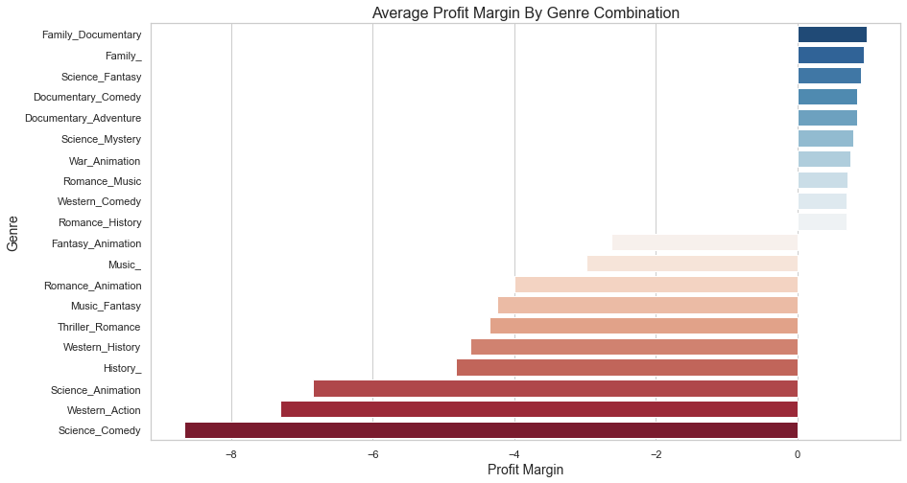

Average Profit by Genre
Dual Genres generally fare better than single Genre
High Profit does not translate into high Profit Margin
Documentary would be a safe choice for profit margin
Introduction
Wrangling
Analysis
Machine Learning
Conclusion
Notes:
3rd, we will be looking at genre. Dual genre generally fare bette rthan single genres and high profits do not translate to a high profit margin. Based on our analysis, documentaries would be a safe choice for a film to be profitable.
Do note that the graph is showing the Top 10 & Bottom 10 only and we did not include the Romanance History in this analysis as there is only 1 film.

Slide 8
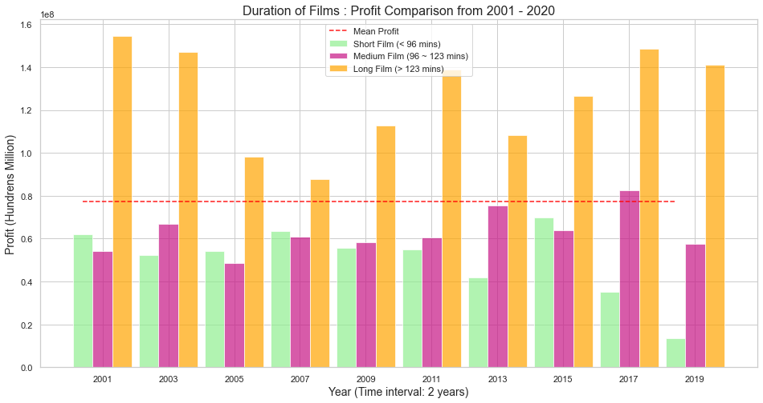
Profit by Films’ Duration
Films longer than >123 mins fetch higher Profits
This phenomenon can be observed since early 2000s, having a parabola effect to 2019
Introduction
Wrangling
Analysis
Machine Learning
Conclusion
Notes:
Lastly, we will be looking at the film’s duration. Films w longer than >123mins of runtime, which is the 75th percentile of movie duration, fetch higher profits.
This phenomenon can be observed since early 2000s, having a parabola effect to 2019
However, it could also be that Longer Runtime tend to have a Larger Budget which led to Higher Profit.

Slide 9
Machine Learning
Logistics Regression to predict whether a movie will be profitable based on attributes that are only available prior to it's release.
The Attributes:
Budget, Popularity,
Avg_Cast_Var,
Director_Var,
Production_Var,
Day_Of_Week,
Month,
genre_combo,
Run Time
Introduction
Wrangling
Analysis
Machine Learning
Conclusion
Notes:
Next 3 minutes of your presentation
We choose Logistics Regression for this Binary Classification Problem, whether a Film will be Profitability. By using the Attributes: xxxx, it aims to let us know if an Investor should invest his/her money into a Film based on the attributes that are only available prior to it's release. This is crucial as it could be the breaking point/ risk tolerance of an investor before they make their move.

Slide 10
Implementation Steps
ROC
RFECV
Modelling
Data Transformation
Introduction
Wrangling
Analysis
Machine Learning
Conclusion
Notes:
This are the brief Steps we took for Machine Learning.
Data Transformation -> Recursive Feature elimination -> Modeling and ROC Curve

Slide 11

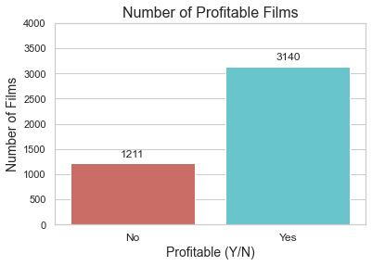

Data Preparation
Generate Dummy Variables
Reference Level: day_of_week_fri, month_apr, genre_combo_Action_
2. Train-Test-Split with Stratify
3. Standardisation
Introduction
Wrangling
Analysis
Machine Learning
Conclusion
Notes:
In order to allow Categorical Variable to fit Logistic Regression Model, we learnt one-hot encoding to convert Categorical Variable into Dummy Variables (1/0).
One level of each categorical feature will become the reference group during encoding, in our case it’s day_of_week_friday, month_apr, genre_combo_Action_
Next, we Train Test Split with Stratify to maintain the imbalanced ratio of unprofitable/profitable in Train and Test Dataset. Lastly, standardising all our numeric variables such as Budget, VAR, Runtime, this is because our data such as Budget are too wide spread. Having budget from 100,000 to 400 Million.
Since the range of values of raw data varies widely, in some machine learning algorithms, objective functions will not work properly without standardising.
Simply put because one level of your categorical feature (here location) become the reference group during dummy encoding for regression and is redundant.

Slide 12
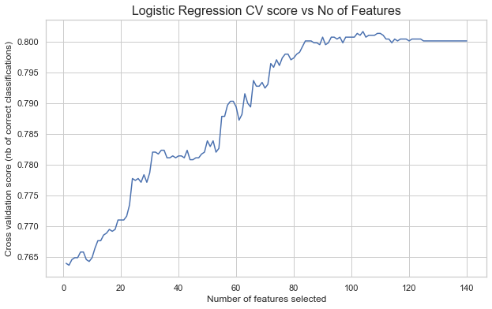
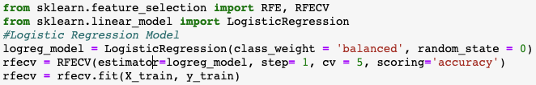

Recursive Feature Elimination Cross Validation
Before
RFECV
Optimal Features: 104
Introduction
Wrangling
Analysis
Machine Learning
Conclusion
Notes:
Next, we perform Recursive Feature Elimination Cross validation, to recursive eliminate Features/Attributes that are not significant in predicting Profitability. RFECV maintains accuracy by splitting the train dataset even further by performing cross validation. From the Function, we now know 104 Features are good to predict the Profitability. Reducing from 140 Features.

Slide 13
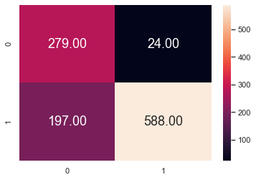
Fit and Model
Classification Report
Confusion Matrix
The Model is 0.96 right in predicting Profitable Film, which is what we want.
 | Precision | Recall | FI-score | Support
0 | 0.59 | 0.92 | 0.72 | 303
1 | 0.96 | 0.75 | 0.84 | 785
Accuracy |  |  | 0.80 | 1088
Macro Avg | 0.77 | 0.83 | 0.78 | 1088
Weighted Avg | 0.86 | 0.80 | 0.81 | 1088
Opportunity Lost is better than Money Lost!
Introduction
Wrangling
Analysis
Machine Learning
Conclusion
Notes:
Next, Fitting our Logistic Regression Model with Train Dataset, and predict our Transformed Test Data as well.
Here are the Confusion Matrix and Classification Report.
Our Classification Accuracy is 0.80, although great, we looked beyond that and checked Precision.
Our model is 96% right in predicting profitable film, but lower in predicting unprofitable film. Classifying more profitable films into unprofitable category. However, this is still good as Opportunity Lost is much better than Money Lost. We rather an investor miss an investment opportunity than making a wrong investment. Hence, higher precision in profitable prediction is what we need.
* Recall: Our Model have high accurately identifying unProfitable Films (0.92) but weaker in identifying Profitable Films
* Precision: However, Our Model is 0.96 right in labelling Profitable Film, which is what we want but many profitable
* Support: The Ratio between Unprofitable - Profitable

Slide 14
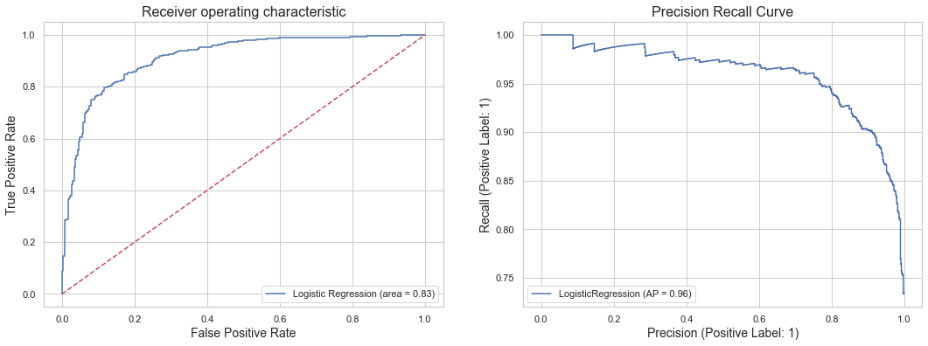
ROC and Recall Curve
Good Precision and Recall
Introduction
Wrangling
Analysis
Machine Learning
Conclusion
Notes:
An ROC curve (receiver operating characteristic curve) is a graph showing the performance of a classification model at all classification thresholds, common tool used with binary classifiers. This curve plots two parameters:
True Positive Rate
False Positive Rate
The dotted line represents the ROC curve of a purely random classifier; a good classifier stays as far away from that line as possible (toward the top-left corner).
Our data is a little imbalance with 3:7, hence we also plotted the Precision Recall Curve, a measure of success of prediction when the classes are imbalance. In information retrieval, precision is a measure of result relevancy, while recall is a measure of how many truly relevant results are returned. As Precision Increases, the recall rate still maintains until a certain threshold beyond 0.78 which falls drastically afterwards. Overall our model is good in Precision and Recall.

Slide 15
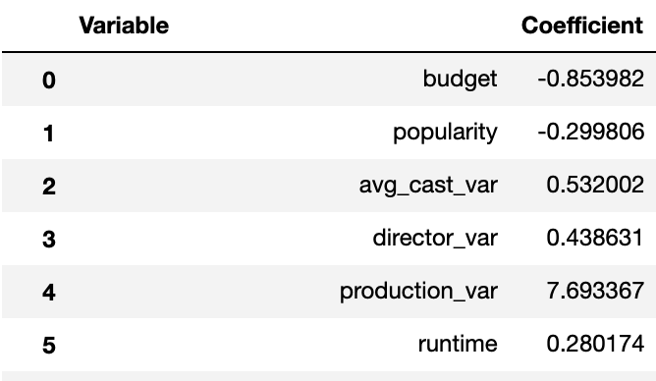
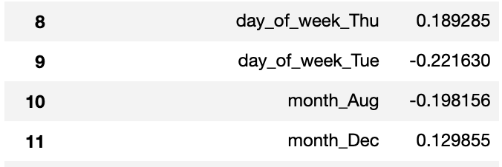
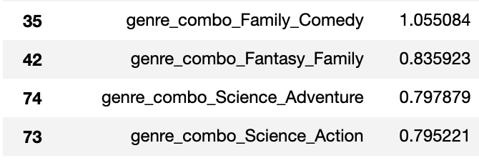
Interpreting Result
Explanation
Exp(-0.85) -> 0.42
Exp(0.53) -> 1.69
1. For Categorical, odds ratio is to a referenced Categorical Data
2. Numerical is in terms of SD, odds to increase Profitability.
Exp(1.055) -> 2.87
3. Matches with EDA insights
Introduction
Wrangling
Analysis
Machine Learning
Conclusion
Notes:
Explanation
The following diagram is truncated.
For Categorical Attributes such as Genre, Month, Day_Of_Week, the odds ratio is to their first Categorical Data lexicographically. For Example month reference is reference with April. Genre is referenced against Action, Day is reference against Friday.
For Example, genre_combo_Family_Comedy is exp(1.055) -> 2.87 times to genre_combo_action (1), bringing more odds to a film profitability.
Meanwhile for Numerical Attributes are scaled by StandardScaler, we need to think of them in terms of Standard Deviation.
For Example: There is 69% increase in odds of having Profitable Film for every standard deviation increase in avg_cast_var -> exp(0.532) -> 1.69. Similarly, for every SD increase in budget, there’s 42% increase in odds of unprofitable.
This matches with our insights in EDA, in which December is optimal to release, Genre that bring profit are Family. Comedy, Science and Adventure theme. Budget should be kept to minimum, longer runtime film excel. Release Date should be Dec. While other months have negative co-efficient. Jan July and June as shown to have higher profitability are neutral or deemed insignficiant.

Slide 16
Conclusion
Problem Solved - Key Insights from EDA & Modelling
Production Studio, Director & Cast are Important for Profitability (1 out of top 5)
Higher Runtime has a Higher Probability of Profitability (>123 min)
Higher Budget does not Translate to Higher Profitability
Science & Adventure and Family & Comedy genres are expected to be profitable
Release Date can be Dec for higher Profitability.
Introduction
Wrangling
Analysis
Machine Learning
Conclusion
Notes:
In conclusion, our Logistic Regression Model managed to solve our problem, to determine if a film will be profitable before investment. In this case, we also determined which attributes a Investor should look out for before investment.
In this case, Production Studio, Director and casting are very important for Profitability.
The top 5 of each VAR name graphed in the Notebook, namely Marvel Studio, Walt Disney, Chris Buck (Director) and Bonnie wright (Actress) Names that are familiar in the film Industry.
Genre -> Avoid Thriller Themes
Release date can be Dec for Higher Profitability, matched between EDA and ML.

Slide 17
Additional Learnings
Regular Expression
Dummy Variable/ One-Hot Encoding
Receiver Operating Characteristic (ROC) Curve
Recursive Feature Elimination Cross Validation (RFECV)
Importance of Cross-Validation
Decoding JSON format during the use of an API
CZ1115 | AY20/21 S2
Notes:
Regular Expression was used to remove certain type of string, initially we also used to extract data but was scrapped.
Dummy Variable / One-Hot Encoding, which were needed to handle Categorical Data in Logistic Regression Model, such as Day_of_week and Genre
Receiver Operating Characteristic Curve to further determine if our Model is good at classification
Recursive Feature Elimination Cross Validation -> Reduce the amount of Features used, as some features are unsignficiant.
Importance of Cross-Validation -> Allowed us to used all of the Dataset, parameter tuning allowing us to find the best parameter to use.
Lastly, the decoding of JSON format during the use of API.

Slide 18
Workload Distribution
Ameeshi
Darren
Jia Cheng
Analysis Production VARs
Editing of slides
Filming
Runtime Analysis
Popularity Analysis
Machine Learning
Reference Material
Slides, Visuals and Filming
Data Extraction, Cleaning, Preparation
Rest of EDA
Machine Learning
Slides and Filming
Please checkout our notebook too, there’s additional sub questions there.
CZ1115 | AY20/21 S2

Slide 19
References
https://stackoverflow.com/questions/38640109/logistic-regression-python-solvers-defintions
https://towardsdatascience.com/building-a-logistic-regression-in-python-step-by-step-becd4d56c9c8
https://medium.com/analytics-vidhya/adjusting-for-inflation-when-analysing-historical-data-with-python-9d69a8dcbc27
https://github.com/YashMotwani/TMDB-Movies-Dataset-Investigation-/blob/master/TMDB_Movies_Dataset_Analysis.ipynb
https://medium.com/analytics-vidhya/implementing-linear-regression-using-sklearn-76264a3c073c
https://towardsdatascience.com/building-a-logistic-regression-in-python-step-by-step-becd4d56c9c8
https://github.com/jeremy-lee93/dsc-mod-1-project-v2-1-onl01-dtsc-pt-052620
https://www.justintodata.com/logistic-regression-example-in-python/
https://stats.stackexchange.com/questions/463690/multiple-regression-with-mixed-continuous-categorical-variables-dummy-coding-s
https://scikit-learn.org/stable/modules/generated/sklearn.metrics.plot_precision_recall_curve.html
https://scikit-learn.org/stable/modules/generated/sklearn.linear_model.LogisticRegression.html
https://www.analyticsvidhya.com/blog/2020/09/precision-recall-machine-learning/
CZ1115 | AY20/21 S2

Slide 20
THANK YOU
Do you have any questions? Please checkout our notebook too, there’s additional questions there.
Ameeshi Gupta (AMEESHI001@e.ntu.edu.sg)
Darren Chan Inn Siew (DCHAN025@e.ntu.edu.sg)
Koh Jia Cheng (C200172@e.ntu.edu.sg)
CZ1115 | AY20/21 S2

